Slide 1
CITI BIKE DATA ANALYSIS
By Mary Akinyi Malowa

Slide 2
Project goal:
To better understand the behavior of Citi Bike’s customer base (both one-time users and subscribers) and how they use Citi Bikes.
This will help us to:
Identify where more bikes should be installed.
Create targeted marketing campaigns that will appeal to different customer segments.

Slide 3
Key questions:
What are the most popular pick-up locations across the city for Citi Bike rental?
How does the average trip duration vary across different age groups?
Which age group rents the most bikes?
How does bike rental vary across the two user groups (one-time users vs long-term subscribers) on different days of the week?
Does the factor of user age impact the average bike trip duration?

Slide 4
Findings and Insights

Slide 5
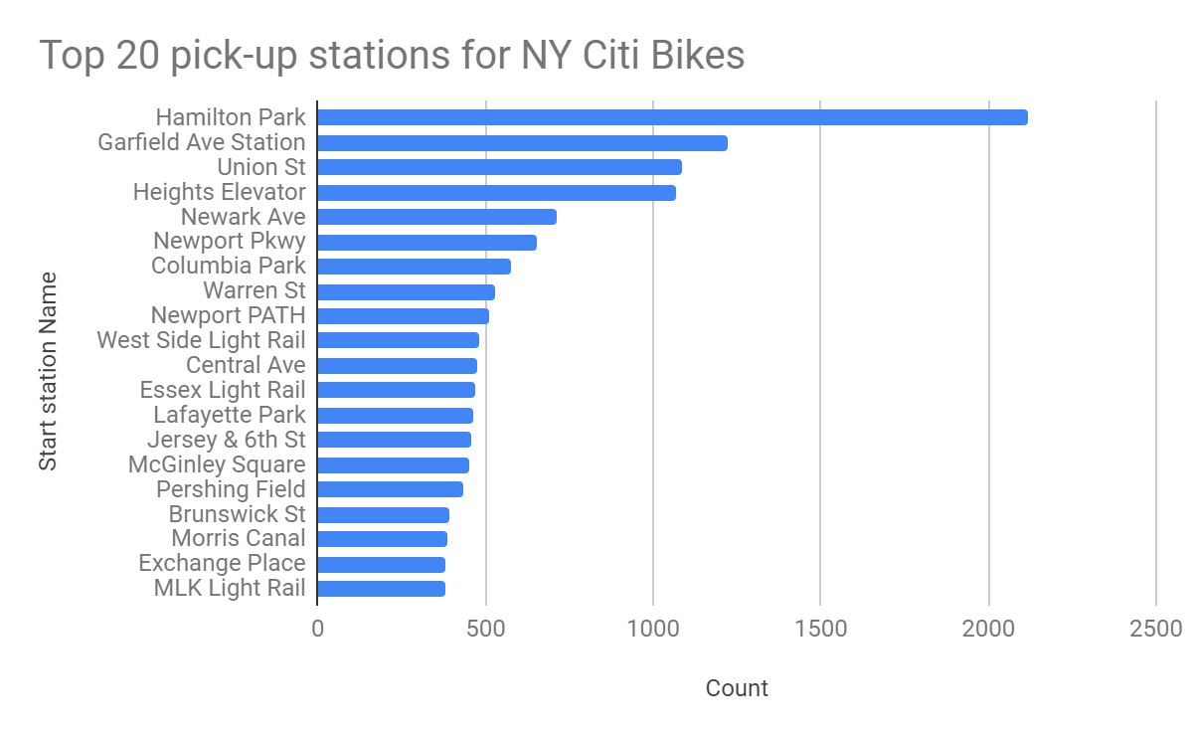
What are the most popular Citi Bikes pick-up locations?
From the analysis, the most popular pick-up locations are; Hamilton Park,Garfield Ave Station,Union St,Heights Elevator,Newark Ave,Newport Pkwy

Slide 6
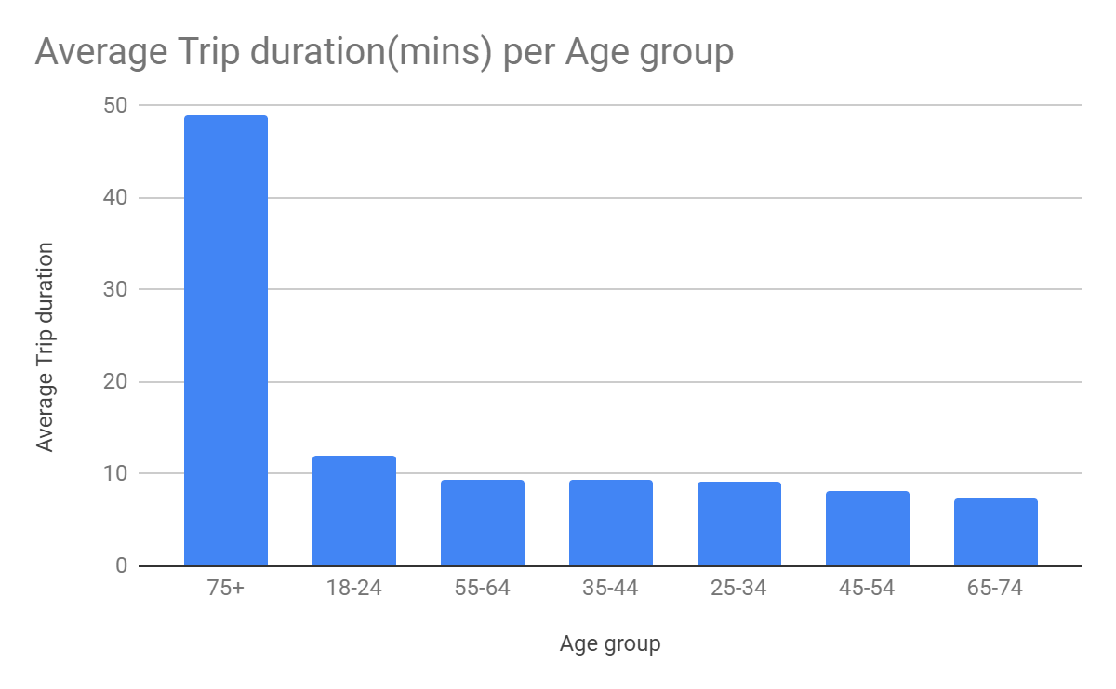
2.How does the average trip duration vary across different age groups?
Users aged 75+ take the longest time on bike rides on average

Slide 7
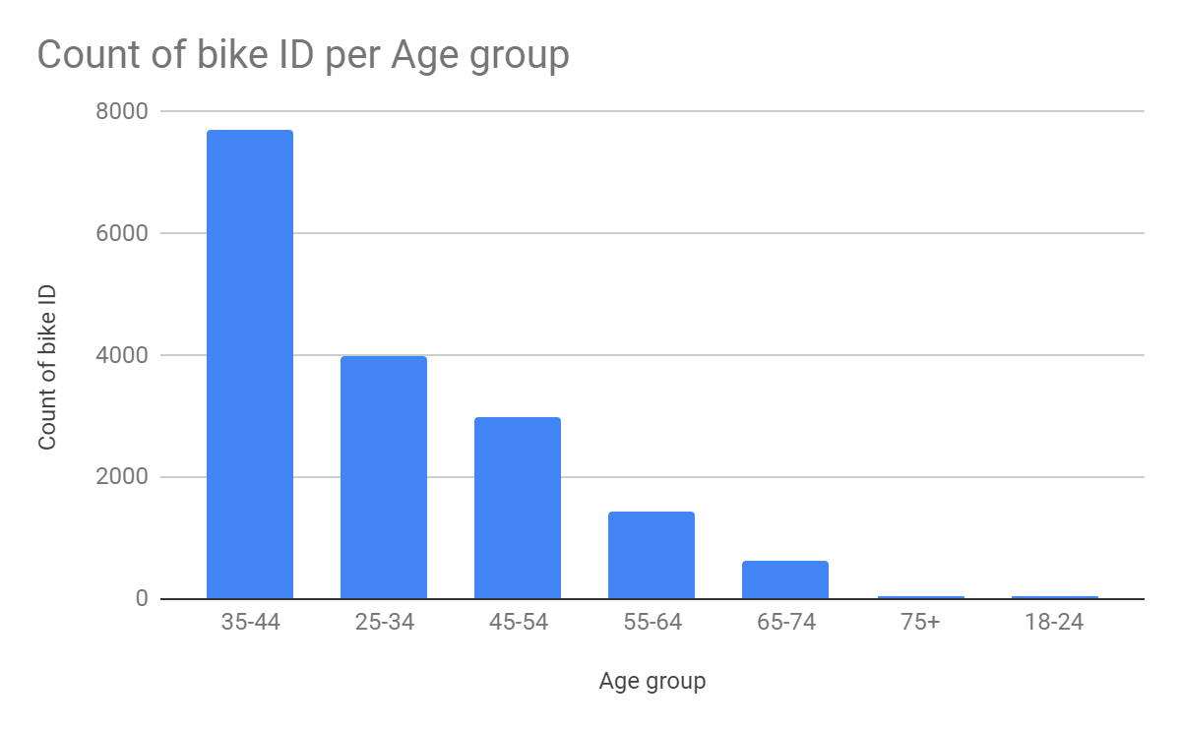
3.Which age group rents the most bikes?
From the chart it is evident that Age group 35-44 rents the most bikes

Slide 8
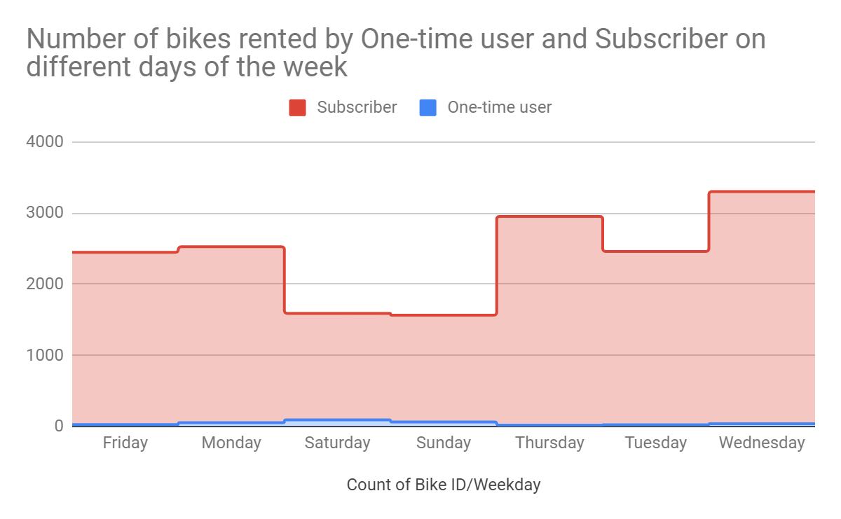
4.How does bike rental vary across the two user groups (one-time users vs long-term subscribers) on different days of the week?
One-time users rent more bikes on weekends as opposed to subscribers whose bike rental is the least during the weekends.

Slide 9
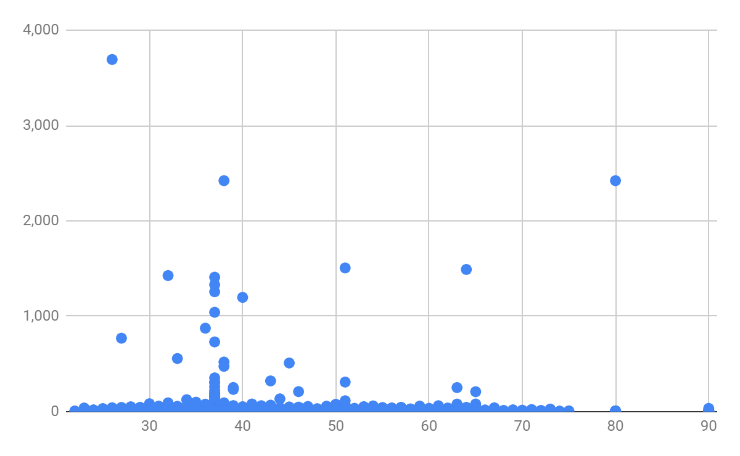
5.Do factors like age impact the average bike trip duration?
From the analysis there is no evident direct relationship between age and the average trip duration.

Slide 10
Summary

Slide 11
Summary of findings:
Top 5 pick-up locations for bikes:
Hamilton Park, Garfield Ave Station, Union St , Heights Elevator, Newark Ave.
Customer base:
Citi Bike's customer base exhibits diverse characteristics in terms of age and user type. The age distribution is varied, with age group exhibiting distinct characteristics, however the age group 35-44 represents the highest frequency of bike rentals.
In terms of user type, the data reveals distinctions in behavior between one-time users and subscribers, particularly on weekends. One-time users tend to rent more bikes during weekends, whereas subscriber activity is comparatively lower during the same period. However, generally the subscribers rent more bikes compared to one-time users confirming their loyalty.
Citi Bike customer behavior:
Users of age 75+ on average take the longest on bike rides while age 35-44 rent the most bikes

Slide 12
Actions and Recommendations

Slide 13
Recommended Actions
Product recommendations:
Install more bikes at the most popular pick-up locations.
Marketing recommendations:
In order to effectively cater to this multifaceted customer base, stakeholders should consider implementing targeted marketing strategies for the age groups and user types, such as personalized marketing campaigns and promotions for weekend ridership, and a more nuanced approach to address the varied preferences and needs of users across different age brackets.

Slide 14
Thank You!

